Slide 1

Lifecycle, Events and Forms
Handling User Interaction
Software University
http://softuni.bg
Software University
http://softuni.bg

Slide 2

Table of Contents
Component Lifecycle
Mounting Phase
Update Phase
Unmount Phase
Handling Events
Forms
Controlled Forms
Uncontrolled Forms

Slide 3
Have a Question?
sli.do #js-web

Slide 4
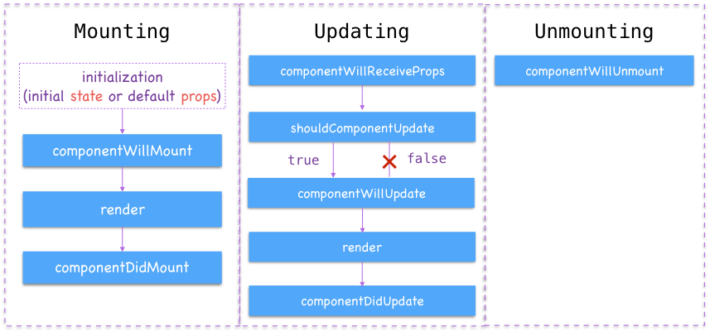
Component Lifecycle

Slide 5
Component Lifecycle
A component has "lifecycle methods" can be overridden to run code at particular times in the process
A component has 3 lifecycle phases
Mounting - The Component and all its children are mounted
Updating – repeated every time a component props/state changes
Unmounting - occurs when a component instance is unmounted

Slide 6
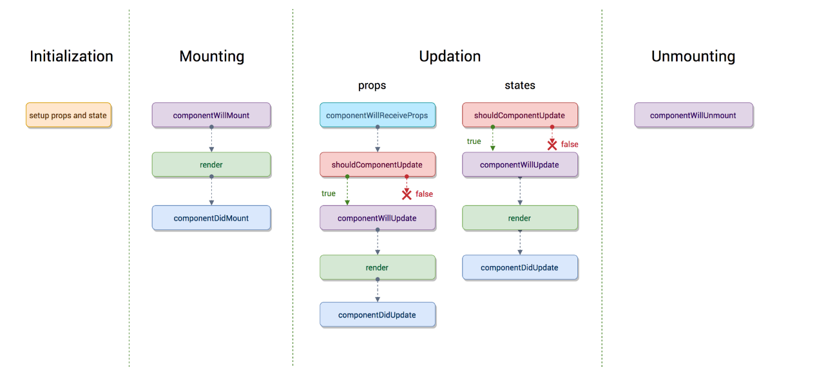
Lifecycle Visualization

Slide 7
Component Mounting
After preparing with basic needs, state and props a Component is ready to mount in the browser DOM.
componentWillMount - executed just before the Component is about to mount on the DOM (executed once in a lifecycle before first render)
render - mounts the component onto the browser
componentDidMount - the hook method which is executed after the component did mount on the dom

Slide 8
Component Updating - State
This phase starts when the react component has taken birth on the browser and grows by receiving new updates.
shouldComponentUpdate - tells when the component receives new state/props, should it re-render or it can skip rendering?
componentWillUpdate - executed only after the shouldComonentUpdate returns true
render - the component gets rendered
componentDidUpdate - the new updated component has been updated in the DOM

Slide 9
Component Updating - Props
List of methods that will get called when the parent sends new props
componentWillReceiveProps - when the props have changed and is not first render
The rest of the methods behave exactly same defined above, in terms of state as well
shouldComponentUpdate
componentWillUpdate
render
componentDidUpdate

Slide 10
Component Unmounting
The component is not needed and the component will get unmounted
componentWillUnmount - the last method in the lifecycle. Executed just before the component gets removed from the DOM
Usage: In this method, we do all the cleanups related to the component

Slide 11
Handling Events

Slide 12
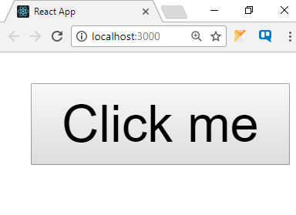
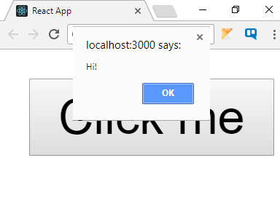
Events in React
React uses synthetic events
Very similar to regular DOM events
Event handling is the same across all browsers in React
function sayHi() {
alert('Hi!');
}
<button onClick={sayHi}>
Hello
</button>
Event names use camel case

Slide 13
Handling DOM Events
Use the HTML event name with camel case
E.g. click → onClick, focus → onFocus, etc.
For a full list, see https://reactjs.org/docs/events.html
There is no need to call addEventListener
If using this inside the listener, you must bind it
Use Function.bind() inside the constructor
Or use an arrow function
Events are pooled – never use them asynchronously!

Slide 14
Handling DOM Events: Example
class Toggle extends React.Component {
constructor(props) {
super(props);
this.state = {isToggleOn: true};
}
handleClick() {
this.setState(prevState => ({isToggleOn: !prevState.isToggleOn}));
}
render() {
return (<button onClick={this.handleClick.bind(this)}>
{this.state.isToggleOn ? 'ON' : 'OFF'}
</button>);
}
}
Event handler
as class method
Bind event listener

Slide 15
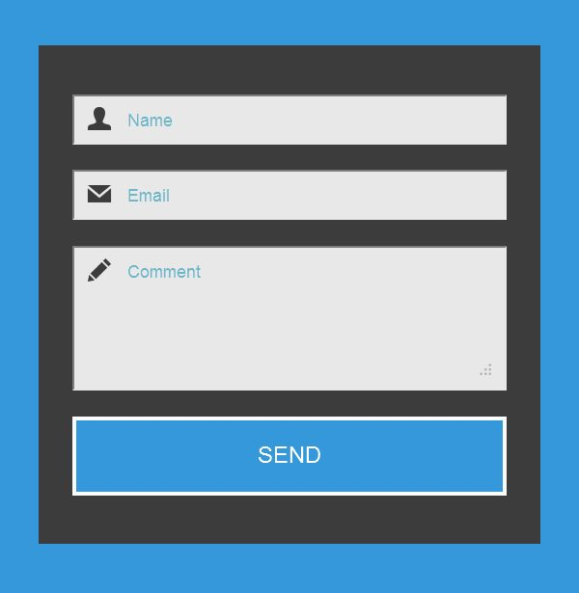
Forms
Controlled and Uncontrolled Forms

Slide 16
React Forms
React provides two standard ways to grab values from <form> elements
The first method is to implement what are called controlled components
The second is to use Reacts ref property and build uncontrolled forms

Slide 17
Controlled Forms
Form inputs are explicitly managed
The value is stored inside the component state
Input is recorded with event handlers
setState
Name:
Component
Pesho
value:
changeHandler
change event

Slide 18
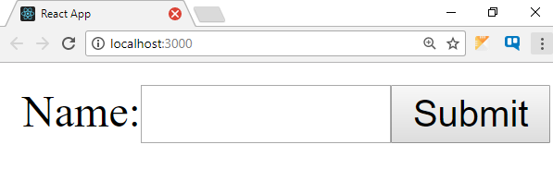
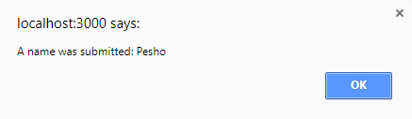
Form Component Declaration
class NameForm extends React.Component {
constructor(props) {
super(props);
this.state = {value: ''};
this.handleChange = this.handleChange.bind(this);
this.handleSubmit = this.handleSubmit.bind(this);
}
handleChange(event) {
this.setState({value: event.target.value});
}
handleSubmit(event) {
alert('A name was submitted: ' + this.state.value);
event.preventDefault();
}
// Continues …
}
Bind event handlers
Pesho

Slide 19
Form Component Rendering
class NameForm extends React.Component {
// Continued …
render() {
return (
<form onSubmit={this.handleSubmit}>
<label>
Name:
<input type="text"
value={this.state.value}
onChange={this.handleChange} />
</label>
<input type="submit" value="Submit" />
</form>
);
}
}
Take value from state
Pesho

Slide 20
Unified Input Approach
React handles all form input elements the same
textarea uses a value prop
select uses a value prop on the root element
Pass an array to select multiple values
<form onSubmit={this.handleSubmit}>
<textarea value={this.state.value} onChange={this.handleChange} />
<input type="submit" value="Submit" />
</form>
<select multiple={ true } value={ ['A', 'B', 'C'] }>

Slide 21
Uncontrolled Forms
The downside to controlled components is the amount of code you have to write
You need a state property to pass to the form element as props
An easier and less labor-intensive way to grab values from a form element is to use the ref property
The DOM nodes are now accessible as this.fullName
<input
type="text"
ref={input => this.fullName = input} />

Slide 22
Using Refs Example
function CustomInput(props) {
return (
<div>
<label>{props.label}:</label>
<input type="text" ref={props.firstName}/>
</div>
);
}

Slide 23
Using Refs Example
class RefsForm extends Component {
handleSubmit = (e) => {
e.preventDefault();
this.firstName.value = 'Changed value!';
}
render() {
return (
<div>
<form onSubmit={this.handleSubmit}>
<CustomInput
label={'Name'}
firstName={input => this.firstName = input} />
<input type="submit" value="Submit" />
</form>
</div>
);
}
}
Pass the DOM Node ref as props

Slide 24
When to Use Refs ?
There are a few good use cases for refs:
Managing focus, text selection, or media playback
Triggering imperative animations
Integrating with third-party DOM libraries
Avoid using refs for anything that can be done declaratively
Don't overuse refs

Slide 25

Summary
React handles events like regular JS
Forms must be explicitly managed
An easier and less labor-intensive way to grab values from a form element is to use the ref property
<button onClick={() => alert('Hi!')}>
Hello
</button>

Slide 26
https://softuni.bg/opencourses/reactjs-fundamentals

Slide 27













SoftUni Diamond Partners

Slide 28




SoftUni Organizational Partners

Slide 29




Trainings @ Software University (SoftUni)
Software University – High-Quality Education and Employment Opportunities
softuni.bg
Software University Foundation
http://softuni.foundation/
Software University @ Facebook
facebook.com/SoftwareUniversity
Software University Forums
forum.softuni.bg

Slide 30

License
This course (slides, examples, demos, videos, homework, etc.) is licensed under the "Creative Commons Attribution-NonCommercial-ShareAlike 4.0 International" license

